Slide 1
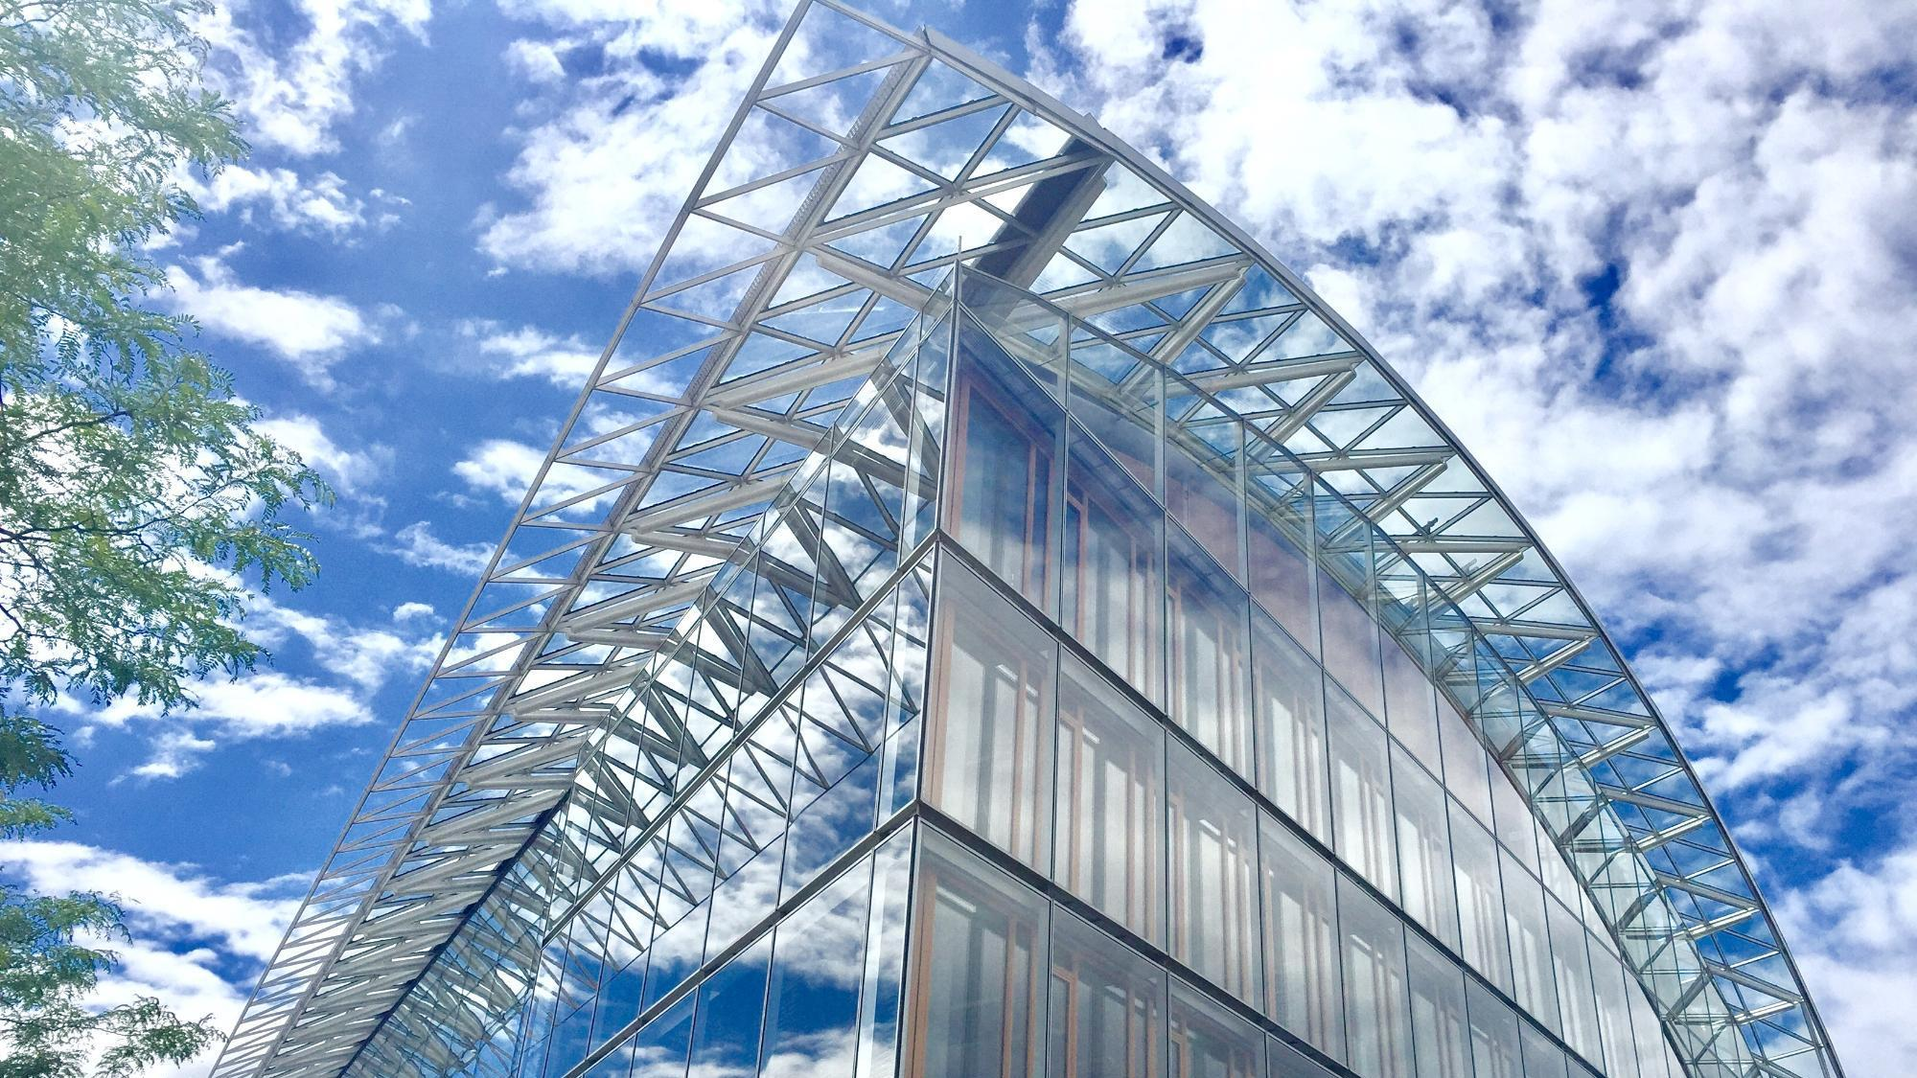
EIB support to Ukraine’s municipal infrastructure
Covenant of Mayors in Ukraine 10 May 2023

Slide 2
Ukraine Early Recovery Programme, UERP
The Financial Agreement between the EIB and Ukraine on the “Ukraine Early Recovery Programme” (UERP) signed on 22.12.2014
Government-controlled areas in Donetsk and Luhansk oblasts, neighbouring Kharkiv, Dnipropetrovsk and Zaporizhzhia oblasts, specific city councils in Kyiv, Poltava, Odesa and Kherson oblasts that were hosting significant number of IDPs
200 mln Euro, EIB’s multi-sector framework loan targeting early recovery investments on critical infrastructure in nine regions affected by the 2014-2015 years conflict in eastern Ukraine
238 sub-projects, from 12,000 up to 5 mln Euro, for the reconstruction of social infrastructure facilities: 52% schools and pre-schools; 26% healthcare facilities; 9% hostels and accommodation for IDPs; 7% culture palaces, libraries; 6% administrative buildings and other infrastructure
Implementation period – 2015-2024
UERP final beneficiaries – central state executive bodies, local state administrations, local self-governments, state and municipal enterprises

Slide 3
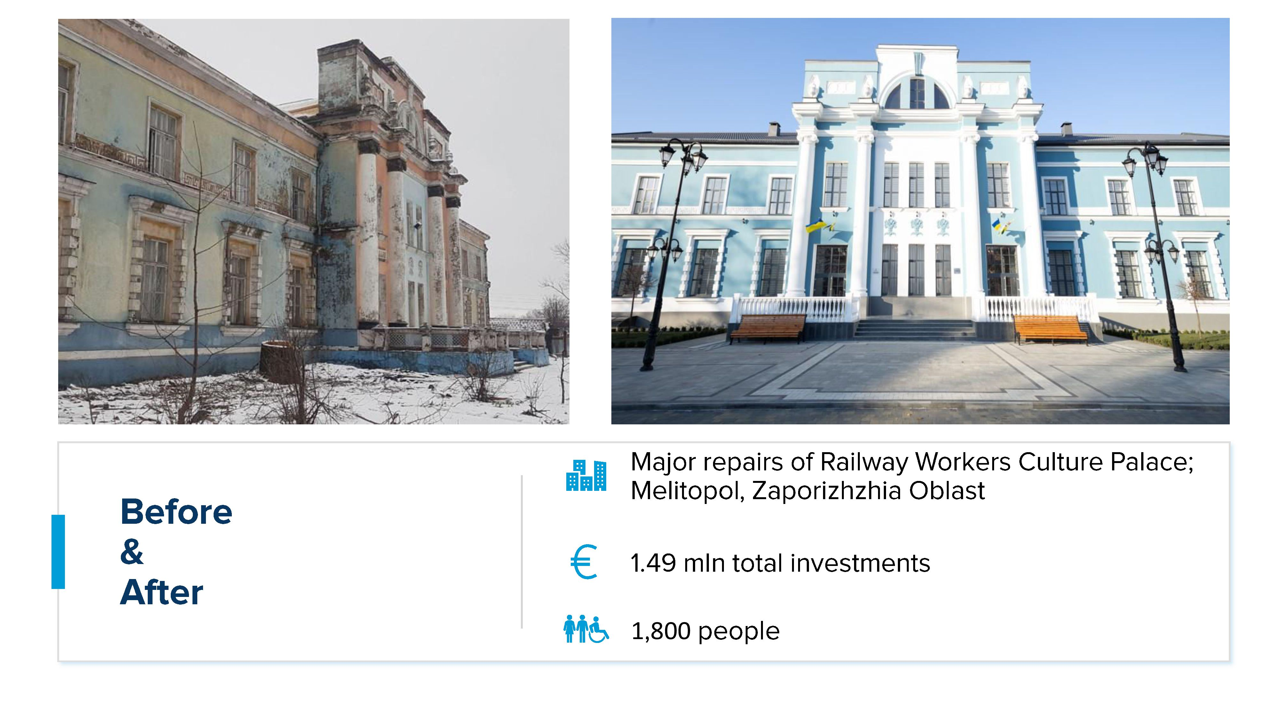
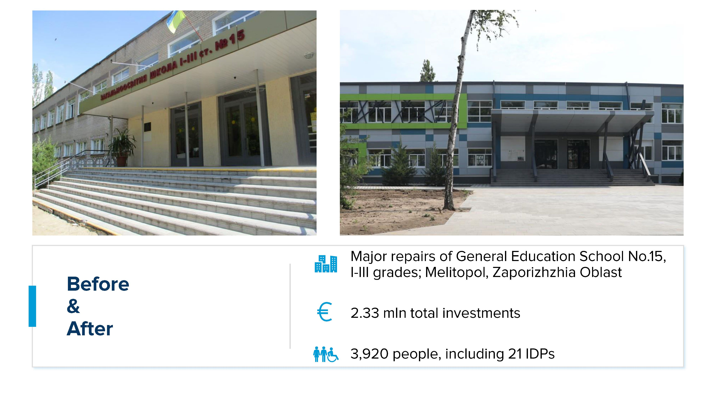
Ukraine Early Recovery Programme, before and after

Slide 4
Ukraine Early Recovery Programme results
91 sub-projects were completed in 29 cities and communities in 8 target oblasts of Ukraine and more than 120 sub-projects were in active construction phase by 23 February 2022
32 hospitals and healthcare centers, 45 schools and kindergartens, 5 residential buildings and hostels, 5 culture facilities and 4 administrative buildings and other objects were completed
Around 7.4 mln Ukrainians in 9 oblasts of Ukraine, including 769000 IDPs and persons from other vulnerable groups, would have received access to quality infrastructure
More than 2200 new jobs were created during implementation of the UERP sub-projects
DURING THE WAR
By February 2023, due to the military aggression, 80 UERP objects have been damaged.
BUT WE ARE REBUILDING!
7 sub-projects were completed in 2022
10 sub-projects are ongoing – construction works in progress

Slide 5
Ukraine Recovery Programme
The Financial Agreement between the EIB and Ukraine on the “Ukraine Recovery Programme” (URP) signed on 9.12.2020×©æ0-
Entire country under control of Ukraine, provided Technical Assistance can safely provide support
EUR 340m, EIB’s multi-sector framework loan targeting recovery investments
EUR 200m allocated to 82 sub-projects for the reconstruction of social infrastructure facilities: 19 hospitals, 48 education facilities, 2 district heating, 4 sewage, 4 water supply and 5 administrative buildings
EUR 140m to be allocated : a new call for proposals expected by May –June 2023 (check MCTID - Min Restoration web site)!
Implementation period – 5 years (initially)
URP final beneficiaries – central state executive bodies, local state administrations, local self-governments, state and municipal enterprises

Slide 6
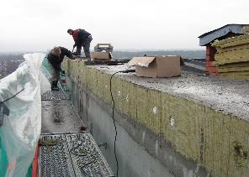
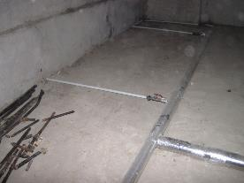
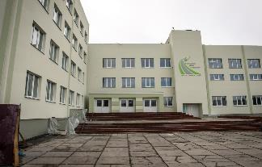
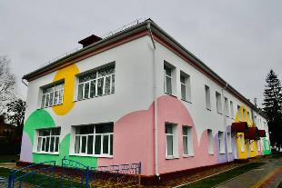
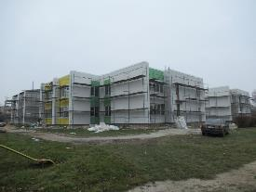
Ukraine Public Buildings Energy Efficiency (UPBEE)
UPBEE is a framework loan of the EIB of €300m, supporting Ukraine in implementing comprehensive refurbishment of public buildings. War damage repair, bomb shelters and building adaptations to suit the needs of Internally Displaced Persons are eligible (up to 50% of project cost).
UPBEE is supported by EU NIP and E5P grants.
UPBEE targets small and medium sized Ukrainian municipalities, so far lacking the possibility to improve public buildings energy efficiency.
Final Beneficiary of the loan:
village council
settlement council
city council
district council
regional council for regional hospitals
For public buildings:
health care facilities,
schools,
kindergartens,
sports facilities,
cultural centres,
buildings of state authorities, etc.

Slide 7
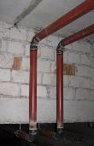
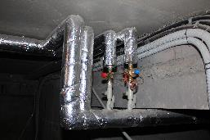
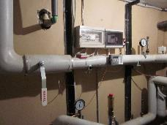
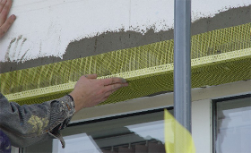
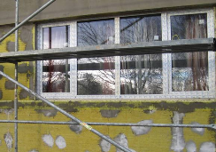
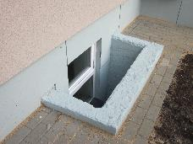
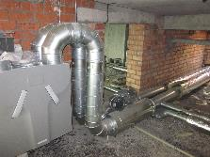
UPBEE: What is the Loan for?
Eligible energy efficiency measures, to be determined by the audit, can include
Thermal insulation of building envelope
Replacement of old windows and doors by new, low-maintenance, energy-efficient
Energy-efficient lighting
Installation of heat recovery systems
Investments in renewable energy sources
Efficient space heating and hot water supply systems, including refurbishment or replacement of heat distribution systems inside the building
Installation of controlled ventilation and air conditioning systems
Installation of building energy management systems (including options for measuring temperature, humidity and CO₂ levels in the premises)
Rehabilitation of natural gas boilers (at building level), including the installation of biofuel boilers
Eligible non-energy efficiency measures (up to 50% of project cost)
Repair of damages caused by the war
Alignment with current Ukrainian standard (access for disabled people, fire safety, bomb shelters…)
Adjustments to the building to make them suitable to host IDPs
Repainting of inside walls and ceiling;
Replacement of flooring such as tiling;
Adaptation of buildings to increase pandemic resilience (new partitioning, marking);
Implementation of COVID-19 related investment in hospitals.
Note: Detailed list provided in Annex 1 "Eligibility and Evaluation Criteria" to the Procedure for the Selection of Final Beneficiaries of the "Energy Efficiency of Public Buildings in Ukraine" Project, approved by order of the Ministry of Community and Territorial Development of Ukraine № 228 of November 29, 2022

Slide 8
UPBEE: Eligibility criteria
Building(s) eligibility
Buildings will remain in public use, have life extension, keep the same functionality and ownership
Benefit a reasonably large population
Not part of an ongoing or planned privatisation procedure
Not part of a concession and/or rent agreement with a private entity and/or ESCO contract
Structural survey proving normal / satisfactory technical condition
Energy audit and/or energy performance certificate
Commit to delivery ex-post energy audit and energy performance certificate
Project cost
Sub-loan not exceed 80% of beneficiary’s borrowing capacity
Energy efficiency costs are at least 50% of sub-project costs
The remaining costs (up to 50%) could finance repair, including for war damages, adjustments and other measures (like installation of showers and kitchens) to ensure the building can better respond to the needs of IDPs and hosting communities
Council support
Decision on municipal borrowing by local Rada (city or regional council)
Decision to finance expenditures associated with VAT payments and other costs which are not covered by the loan by local Rada (city or regional council)
NOTE: Grant support for technical design - municipalities with a population below 50,000 people and limited borrowing capacity can apply for EU NIP grant support

Slide 9
UPBEE: Capital from the Loan funds at favourable terms
5 years grace period
15 years
20 years
Repayment schedule: 20 years, Long Grace Period: 5 years
During the first 5 years you don’t repay the principal but only interest rate for used Loan funds
You begin to pay back the principal after 5 years, at this point the benefits from energy savings and reduced maintenance costs are already largely proved
Low interest rate
Annual interest rate based on Euribor and capital market conditions
Among the lowest rate currently available on the market
Technical Designs and audits offered by EU NIP for the smallest cities (up to EUR 1m)
Investment grant for eligible hospitals offered by EU and E5P
Large technical assistance support : Covenant of Mayors, UNDP, Consultants

Slide 10
UPBEE : Call for Proposals until 3rd June 2023
Call for Proposals to cities/hromadas now until 3rd June 2023: On approval of the Selection Procedure... | dated 29.11.2022 No 228 (rada.gov.ua)
Training on the ministry web site: https://mtu.gov.ua/news/34185.html
EU Press release : https://europa.eu/!bwCgpT
Blog: Програма "Енергоефективність громадських будівель в Україні" (infoupbee.blogspot.com)
Additional information can be obtained by e-mail UPBEE.support@mtu.gov.ua or by phone +380 50 332 61 49 (WhatsApp, Telegram), +380 44 351 46 31
Stakeholders
European Investment Bank, European Union, Ministry for Communities, Territories and Infrastructure Development of Ukraine, Ministry of Finance of Ukraine, E5P, Covenant of Mayors, United Nations Development Programme

Slide 11
THANK YOU
Violaine Silvestro von Kameke
EIB Senior Loan Officer
+352 691 28 56 58
v.silvestro@eib.org

